Slide 1
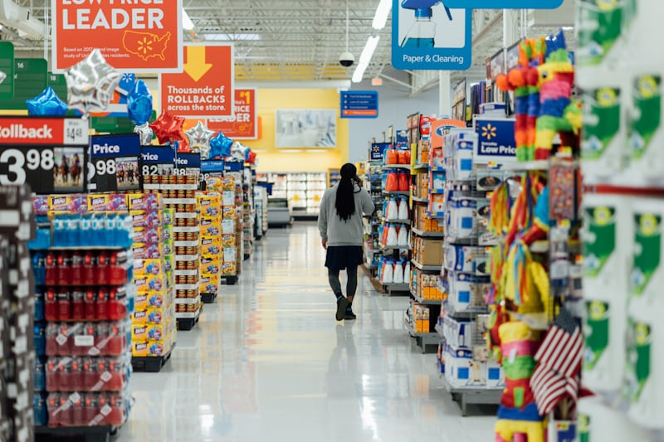
Retail Store Analysis Report

Slide 2
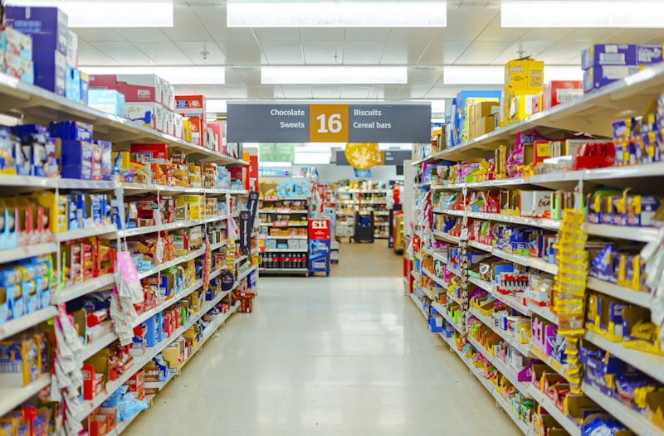
1. Introduction
This report summarizes the sales and customer analysis of a retail store dataset with 50,000 transaction records. The analysis was conducted using Power BI to track performance trends, customer demographics, spending behavior, and product category insights.

Slide 3
Tools Justification
Although the task suggested using Python libraries (Matplotlib, Seaborn, etc.), this analysis was performed in Power BI. The choice was based on two reasons:
1. Skill Level: At the time of the project, Python for visualization had not yet been covered in my learning path, while I had practical experience with Excel and Power BI.
2. Business Relevance: Power BI is widely used in organizations for interactive dashboards, KPI tracking, and storytelling with data, making it a suitable tool for delivering insights to non-technical stakeholders.
This approach ensured that the project outcomes remained aligned with the objectives: transforming raw data into meaningful insights and actionable recommendations , even though a different tool was applied.

Slide 4
Key Findings
Top Products: Cookware led with $1.7M, followed by Football, Jacket, Makeup, Perfume, and others at ~$1.6M each
Top Categories: Home & Kitchen, Clothing, Electronics, Books, Beauty, and Sports all generated around $6M each, indicating a balanced portfolio.
Gender: Sales split almost evenly — Male $9.1M (49.7%), Female $9.2M (50.3%).
Age Groups: Emerging Professionals, Established Adults, and Mature Shoppers dominate, each contributing about $8M in sales.
Low Spenders (31K customers) = $16M
Medium Spenders (14K) = $12M
High Spenders (5K) = $10M → Only 10% of customers but 26% of revenue.

Slide 5
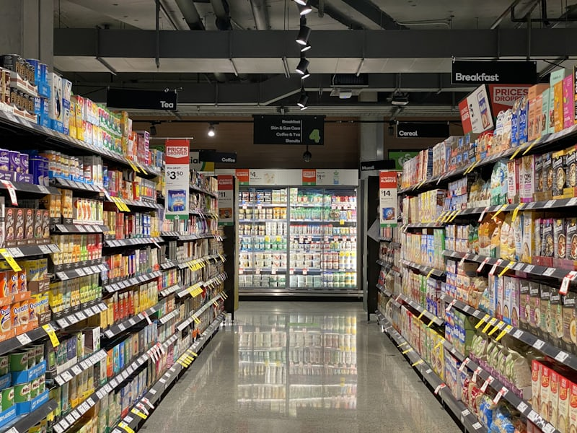
Key Insights
1. Sales Stability: Revenue remained strong but declined slightly in 2022, suggesting the need for new promotions or campaigns.
2. Customer Core: The most valuable customers are Emerging Professionals and Established Adults, both in size and spending power.
3. High Value Customers: Though small in number, High Spenders generate disproportionately high revenue.
4. Category Spread: Revenue is evenly spread across major categories, which reduces risk but limits identification of a single “hero” category.
5. Balanced Gender Sales: Male and Female customers are almost equal contributors.

Slide 6
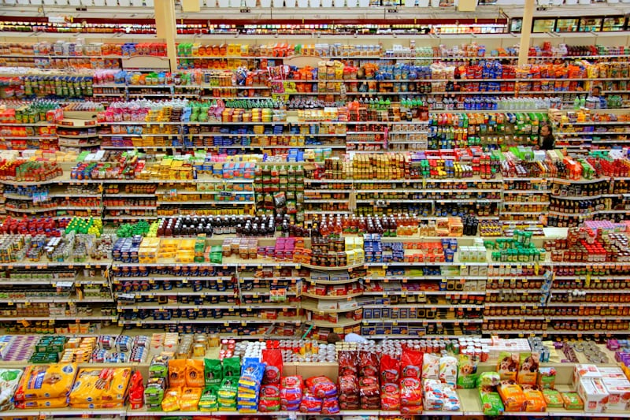
Recommendations
1. Target Mid-Age Professionals: Design campaigns for Emerging Professionals and Established Adults who dominate both count and spending.
2. VIP Loyalty Program: Focus on the High Spenders (10%) who drive 26% of sales. Offer premium membership, discounts, or early access to boost retention.
3. Seasonal Promotions: Sales dipped in 2022. Launch seasonal offers or bundles around peak months to stimulate demand.
4. Product Bundling: Since categories generate similar revenue, bundle products across categories (e.g., Electronics + Accessories, Clothing + Beauty).
5. Balanced Marketing: Maintain equal gender-focused campaigns since both groups are nearly 50/50 in contribution.

Slide 7

Conclusion
The retail store shows a strong and stable performance with a diverse product portfolio and a balanced customer base across gender and categories. Growth opportunities lie in leveraging mid-age professionals and high spenders, along with reinvigorating sales growth through strategic promotions and loyalty programs.

